Slide 1

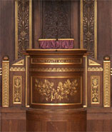
Approaches for the Rapid Processing & Annotation of Mass Spectrometry Data
Jan Stanstrup
Bioactive Foods and Health
Department of Nutrition, Exercise and Sports
Faculty of Science
University of Copenhagen

Slide 2

Eliminating time-consuming tedious work
CAMERA (R)
MetShot (R)
MetFusion (Java+web)

Slide 3
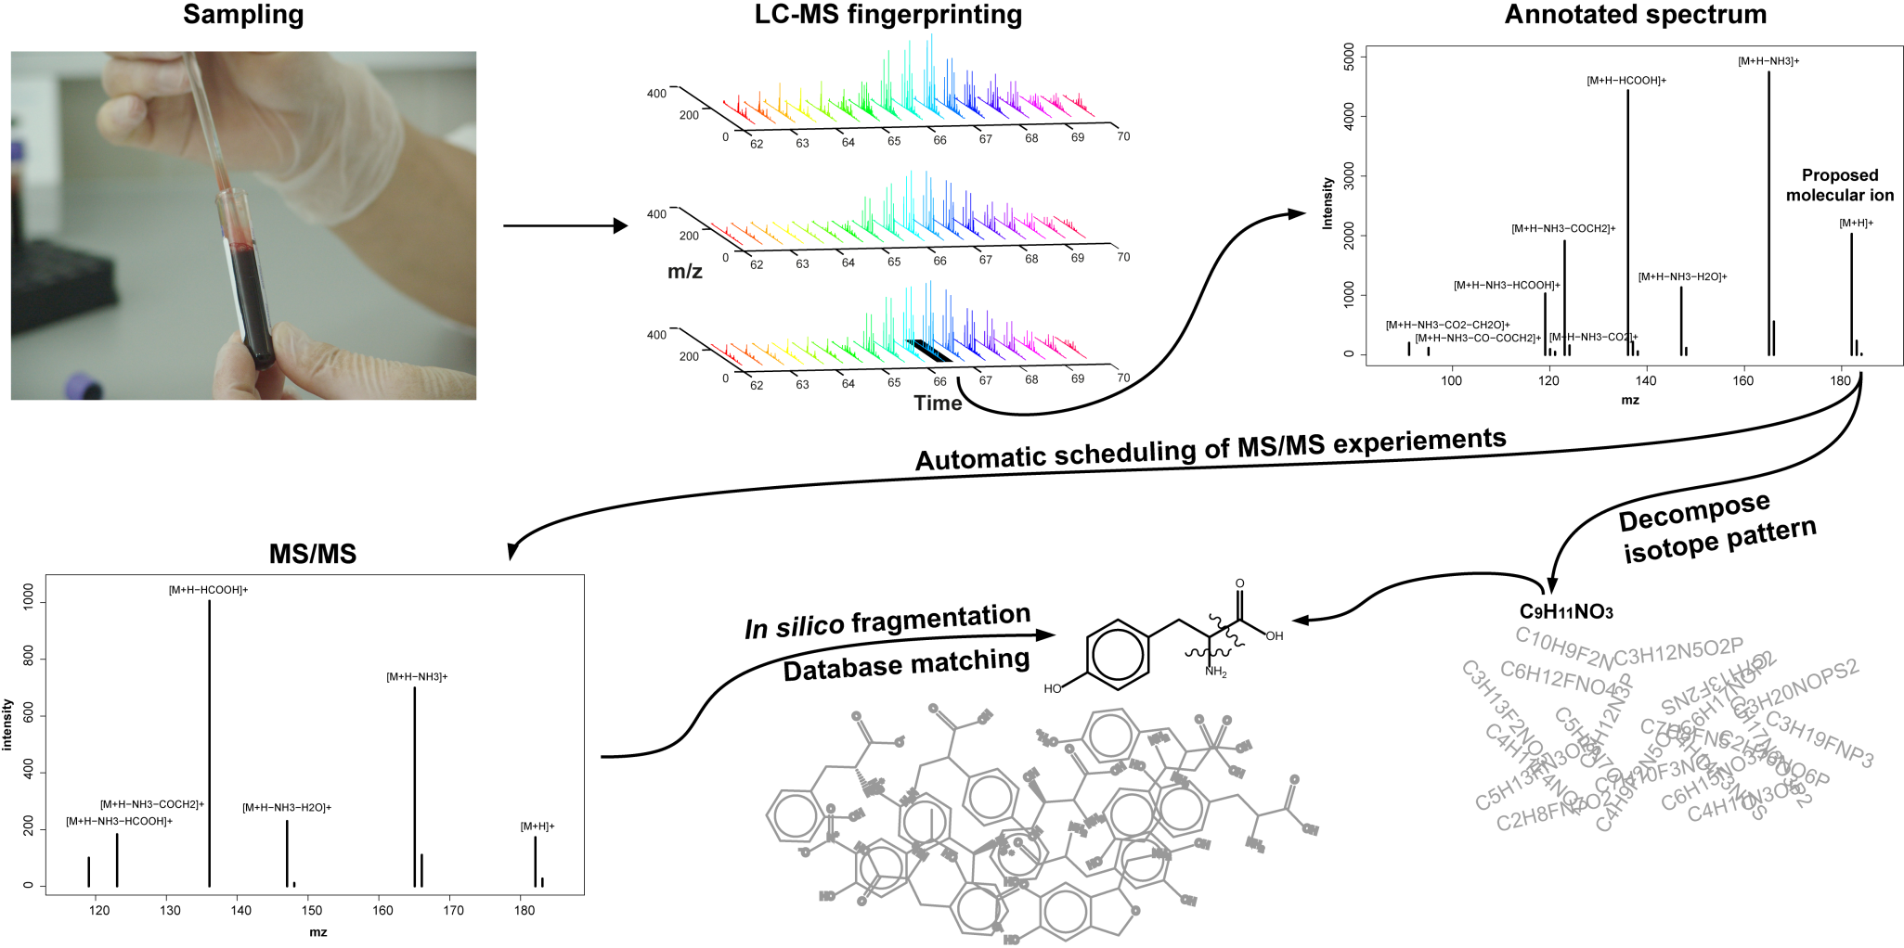
Pipeline for rapid processing & annotation

Slide 4
CAMERA annotation
Feature grouping
Correlation across samples and across peaks
Positive mode
Negative mode
4232
5096
Features
716
1408
Compound spectra

Slide 5
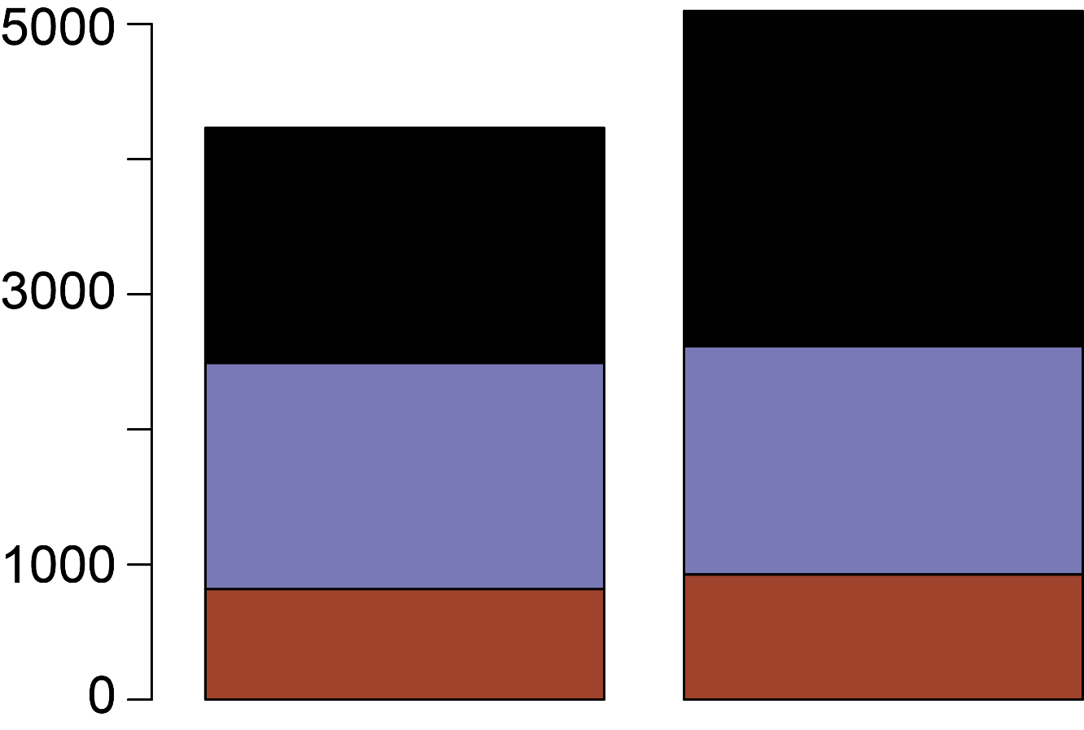
CAMERA annotation
Features
Unannotated
Adducts & fragments
Isotopes
Positive mode
Negative mode

Slide 6
Adducts and fragments (negative mode)
[M+Cl]⁻
[M-H-CO₂]⁻
[M-H]⁻
[M-H-H₂O]⁻
[M-H-C₂H₂]⁻
[M-H+HCOONa]⁻
[M-H-C₂H₂O₂]⁻
[M-H-CH₄]⁻
[M-H-HCOOH]⁻
[4M-4H+Fe³⁺]⁻
[M-2H+Na]⁻
[3M-4H+Fe³⁺]⁻
[M-H-CO]⁻
[M-H-CH₂O]⁻
[M+Cl+NaCOOH]⁻
[M-H+NaCl]⁻
[2M-H]⁻
[2M-4H+Fe³⁺]⁻
[M-2H+K]⁻
[M-H-SO₃]⁻

Slide 7
Pipeline for rapid processing & annotation

Slide 8
Generation of MS/MS experiments
Guestimate of [M+H]⁺ | CAMERA ann.
2) Decent intensity | Enough for MS/MS
3) Not noise | In blanks
4) Which are interesting | Statistics etc.

Slide 9
Feature selection (positive mode)
1173
1173
Non-contaminants
Intensity
209
138
2187
43
44
192
620
[M+H]⁺ or only feature in feature group
Contaminant features: 1173 (28 %)

Slide 10
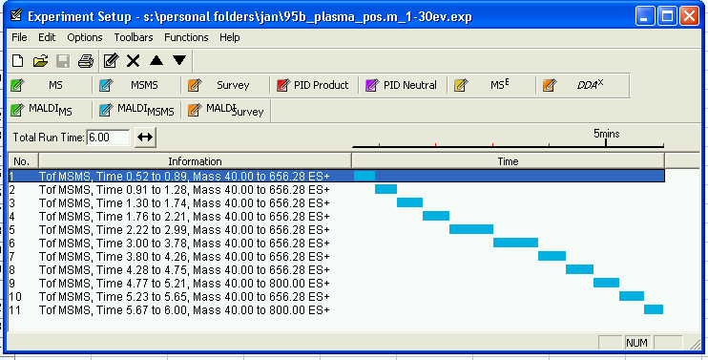
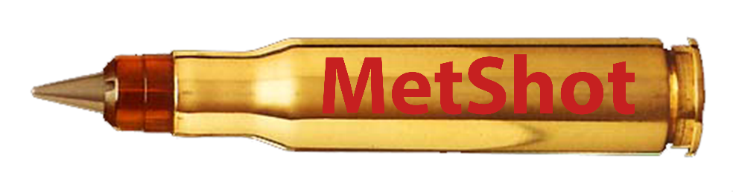
Generation of MS/MS experiments

Slide 11
Pipeline for rapid processing & annotation

Slide 12
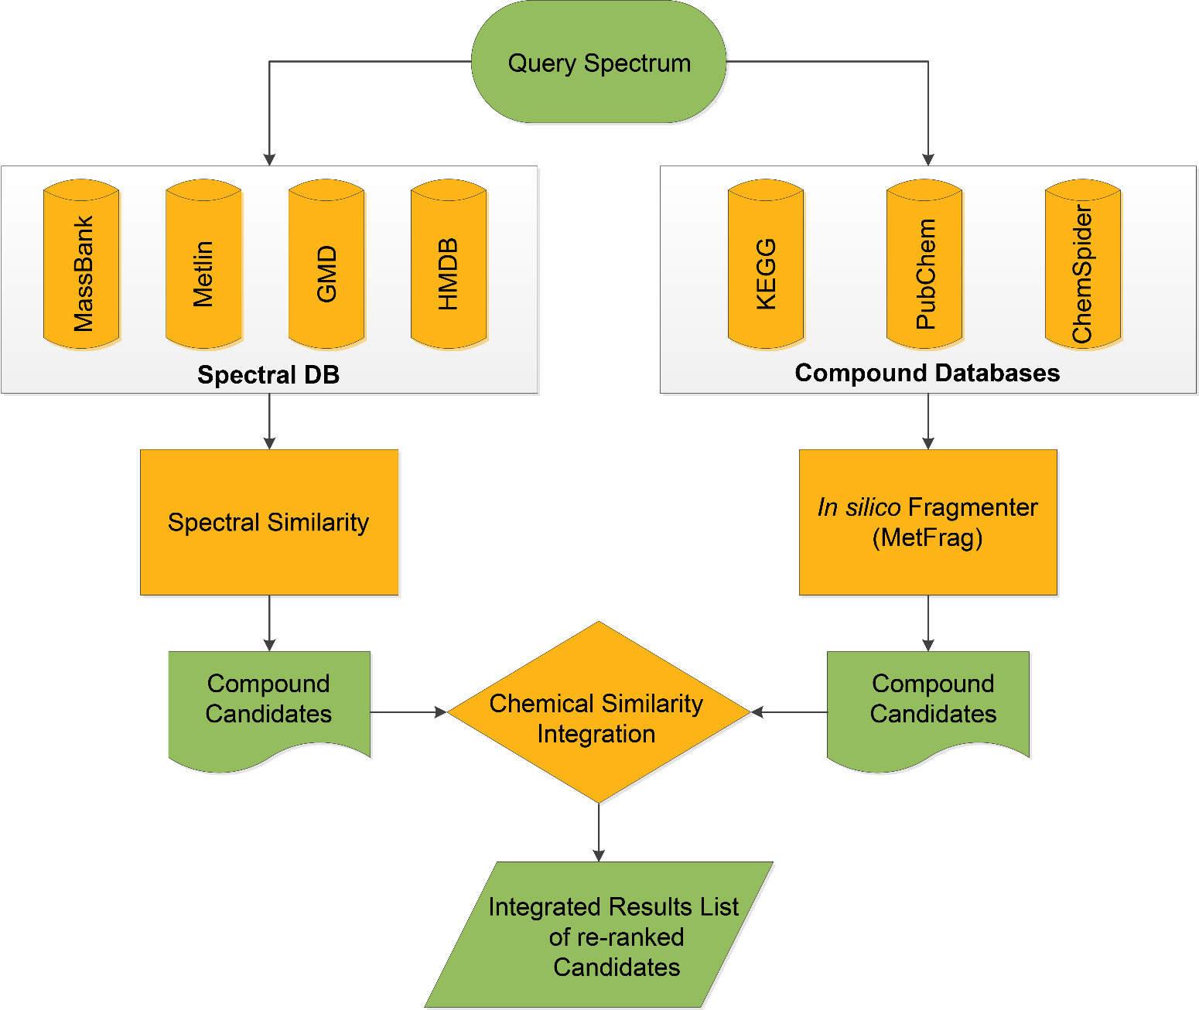
MetFusion
http://msbi.ipb-halle.de/MetFusion

Slide 13
Results of MetFusion identification
Mode | Median rank | Mean rank
POS | 01 | 03
NEG | 21 | 39

Slide 14
Pipeline for rapid processing & annotation

Slide 15
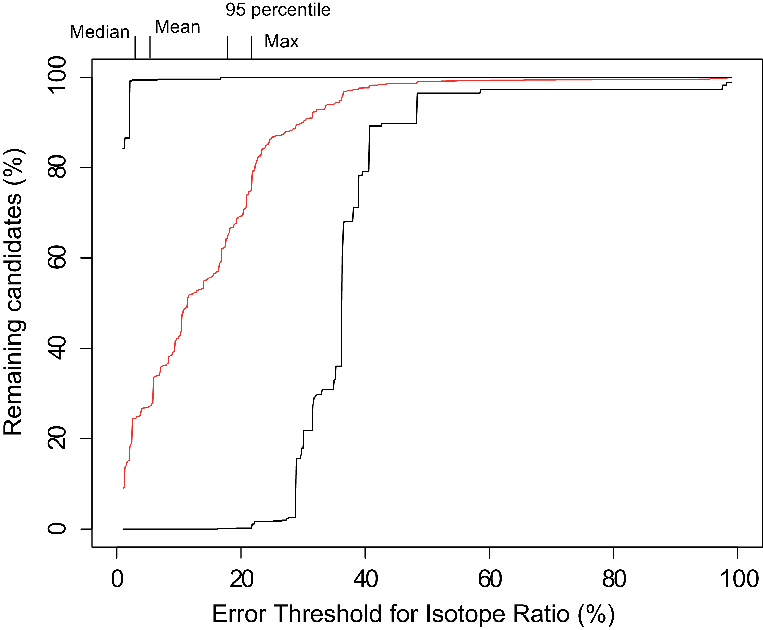
Isotopic ratio

Slide 16
Pipeline for rapid processing & annotation

Slide 17
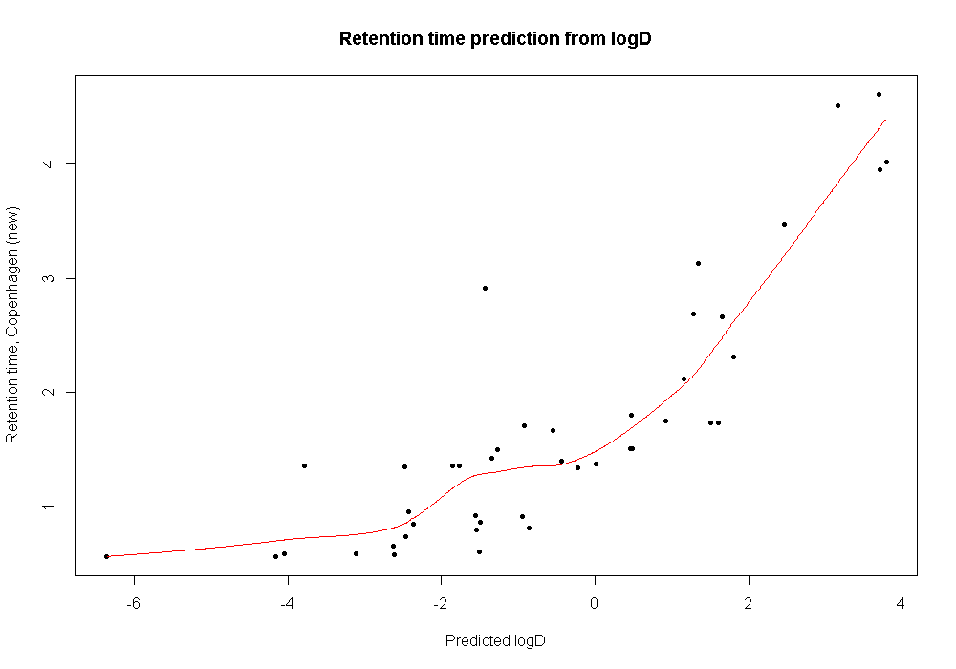
Retention time prediction from logD
4
Retention time (min)
3
2
1
-6
-4
-2
0
2
4
Predicted logD

Slide 18
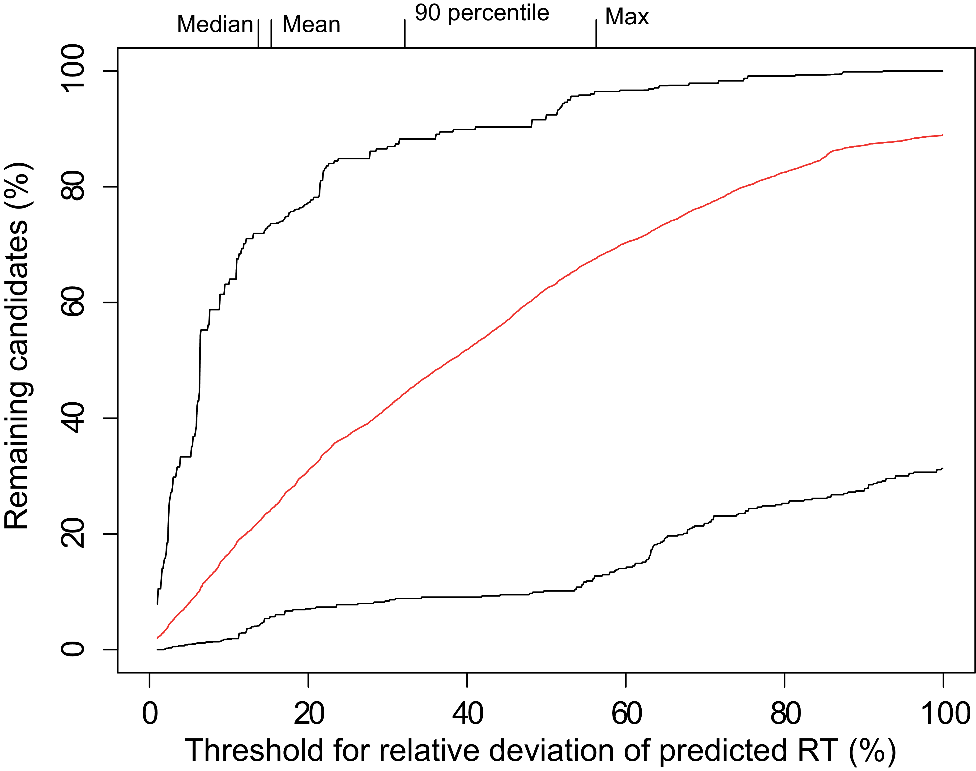
Retention time prediction from logD

Slide 19
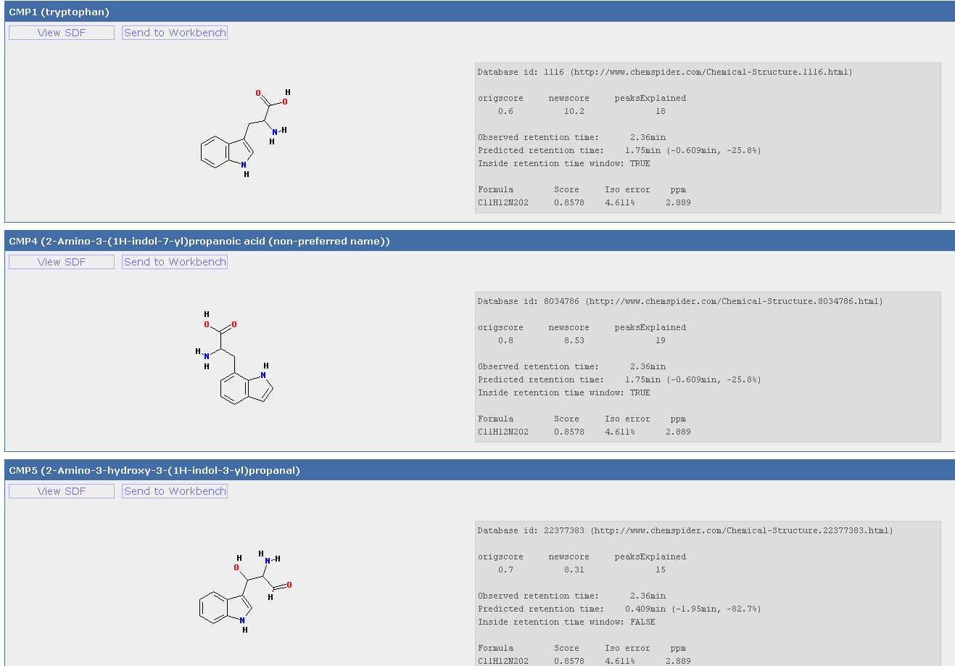
Final Sorted candidate list

Slide 20
Future improvements
Instrument side
Higher sensitivity (immense improvements already achieved)
More accurate isotope pattern determination
Data availability
Extension of spectral databases (especially for negative mode)
Computational
Filter by CAMERA annotation (molecular formular and MetFusion cadidates)
Compound generator*
Improved RT prediction → LogD prediction
*Peron et al. Automated Pipeline for De Novo Metabolite Identification Using Mass-Spectrometry-Based Metabolomics (2013)

Slide 21
Acknowledgements
Rdisop
Professor Lars Ove Dragsted
Bioactive Foods and Health
Department of Nutrition, Exercise and Sports
University of Copenhagen
Dr. Steffen Neumann (XCMS, MetShot, Rdisop)
Michael Gerlich (MetFusion)
Dr. Carsten Kuhl (CAMERA)
Bioinformatics & Mass Spectrometry
Leibniz Institute of Plant Biochemistry (IPB), Halle
Metabolite profiling and beyond: approaches for the rapid processing and annotation of human blood serum mass spectrometry data (DOI: 10.1007/s00216-013-6954-6)

Slide 22
Thank you for your attention

